Slide 1
207 Remote: Introduction to Family Group Decision Making (FGDM): Part II

Slide 2
Section I: Welcome and Introductions

Slide 3
Name Tents
Upper left: Upper right:
County/agency Your current position
at which you work in the agency
Center:
Name
Back :
One thing that you would like
to learn from this training

Slide 4
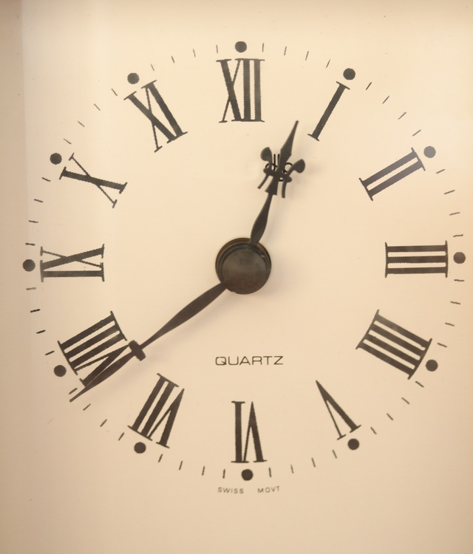
Agenda
Day I:
  Welcome and Introductions
  Review of Family Group Decision Making(FGDM): Part I
  Preparing for the Meeting: Working with Families
  Preparing for the Meeting: The Delicate Balance of Coordinating
  Preparing for the Meeting: Working with Service Providers (Continued to Day 2)

Slide 5
Agenda
Day II:
  Preparing for the Meeting: Working with Service Providers (Continued from Day 1)
  The Meeting: Phase I & Phase II
  The Meeting: Phase III
  The Meeting: Phase IV
  After the Meeting: lan Follow-up/Meeting Follow-up
  Mock Family Group Decision Making Meeting
  Wrap-up and Evaluation

Slide 6
Competency and Learning Objectives
Competency
  207-4: The child welfare professional can use assessment data to collaboratively develop an appropriate, culturally competent case plan with the family, and can develop and link supportive family and community resources.
Learning Objectives
  Participants will be able to:
    Coordinate the FGDM process; and
    Facilitate an FGDM meeting.

Slide 7
Strengths Interview
Identify an interviewer, interviewee, and an observer.
The interviewer should solicit three strengths from the interviewee, writing each strength on a separate 3x5 index card. The interview should take 2 to 3 minutes. The observer should observe the interaction between the other two and take note of how the interaction occurs. When the interview is complete, take 2 to 3 minutes to process how the activity felt.
Rotate roles (i.e., interviewer, interviewee, and observer) clockwise until each person at the table has had the opportunity to fill each of the roles, allowing 2 to 3 minutes for each interview.

Slide 8
Section II: Review of Introduction of Family Group Decision Making (FGDM): Part 1

Slide 9
Family Group Decision Making (FGDM): Part I Review
What are the four stages of the FGDM process?
What are the six questions to consider when “Stacking for Success”?
What parties are involved in the FGDM process?
  For each party, offer two to three things for which that party is responsible.

Slide 10
Learning Objectives from Part I (Overview of FGDM)
At the end of the training, participants will be able to:
  Describe the FGDM process;
  Identify values and beliefs that drive the FGDM process; and
  Complete a referral for the FGDM process.

Slide 11
Section III: Preparing for the Meeting: Working with Families

Slide 12
Coordinator’s Initial Meeting with the Referral Source
Review the information on the referral form
Clarify the Purpose
Identify any potential dates for the Pre-Conference meeting and the FGDM meeting
Widen the Circle
Discuss any family dynamics that may have an impact on the process
Exploring any safety-related issues
Review the Stacking for Success questions

Slide 13
How to Engage Children
What strategies do you currently use to build rapport with children?
What additional strategies could be used?

Slide 14
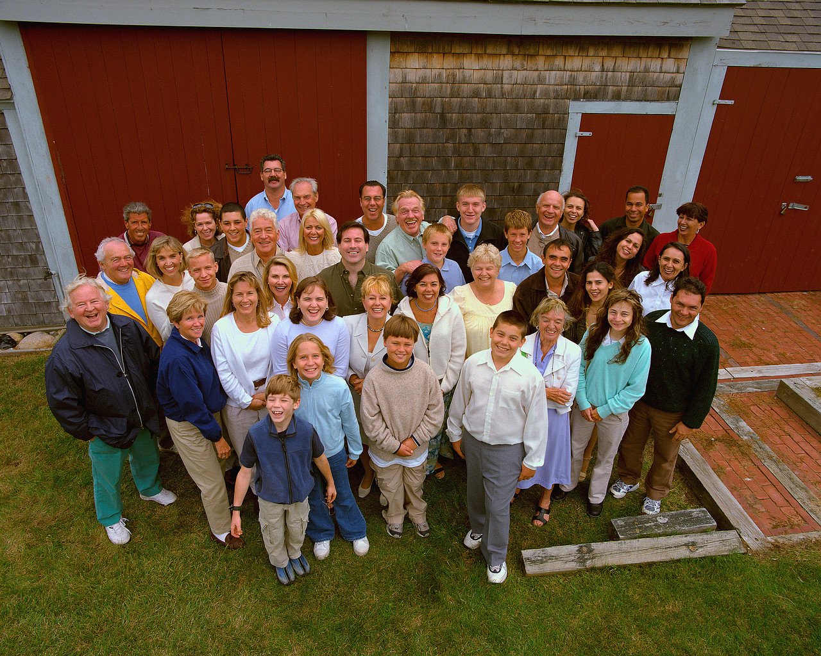
Tools for Discovering Connections
Connectedness Mapping
Historical Mobility Mapping and Flow Diagrams
Connectograms

Slide 15
Section IV: Preparing for the Meeting: The Delicate Balance of Coordinating

Slide 16
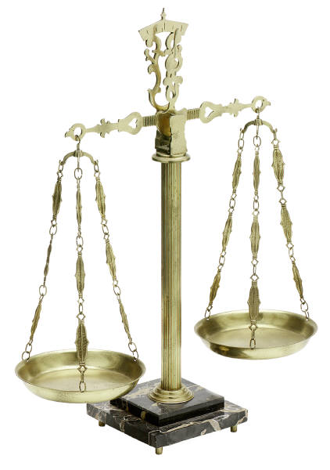
The Delicate Balance of Coordinating
Who is Invited?
Information Sharing
Safety Issues
Neutrality
Scheduling

Slide 17
Section V: Preparing for the Meeting: Working with the Service Providers

Slide 18

A Good Purpose Statement…
Addresses Safety, Permanency, Well-being and/or Balanced and Restorative Justice;
Motivates everybody to attend;
Is significant enough to have all the family invested in attending;
Is mutually agreed upon by all who attend the meeting; and
Is clear and understandable.

Slide 19
Pre-Conference
Held prior to the FGDM meeting
Involves FGDM staff and Service Providers
Purpose is to discuss the purpose and goals of the FGDM meeting
FGDM Pre-Conference Involves:
  Introductions
  Explanation of the paradigm shift
  Discussion of roles
  Review of the purpose
  A brief overview
  Safety considerations
  Discussion of strengths
  Discussion of concerns:
    Familial
    Bottom-line
  Identification of resources

Slide 20
Service Provider Responsibilities
Be positive
Use family-friendly, non-clinical language
Be prepared to:
  Discuss strengths and concerns
  Explain what your agency does
  Share services available in the community
  Uphold confidentiality
  Support the family plan
  Follow through with implementation

Slide 21
Section VI: The Meeting: Phase I & Phase II

Slide 22
Phase 1:
Welcome & Introductions
Family Ritual
Roles
Purpose
Guidelines

Slide 23
Phase 2:
Information Sharing
Strengths
Concerns
Family Concerns & Bottom-Line Concerns
Resources

Slide 24

Underlying Concerns
The following questions will help you identify the concern under the concern:
  Can you tell me more about that?
  What concerns you most about that?
  What worries you most about that?
  Do (or did) you know that they worry about that?
  Can I ask them why they worry?
  Would it make sense to…?
  I know this is difficult to talk about, but can you tell me more about that?

Slide 25
Section VII: The Meeting Phase III

Slide 26
Phase 3:
Private Family Time

Slide 27
Section VIII: The Meeting: Phase IV

Slide 28
Phase 4:
Presentation of Family Plan and Acceptance
Family Ritual
Conclusion

Slide 29
What Participants Think: Recommendations and Safety
Data from the FGDM Statewide Evaluation suggests a majority of natural supports and professional supports would recommend FGDM to other families and believe children will be safer as a result of the plan.
Natural supports include biological and step parents, siblings, friends, neighbors, and relatives.
Professional supports include child welfare professionals, JPO, school professionals, and behavioral health providers.
(Statewide FGDM Evaluation, 2015)

Slide 30
Section IX: After the Meeting: Plan Follow-up/Meeting Follow-up

Slide 31
Section X: Mock Family Group Decision Making Meeting

Slide 32
Section XI: Wrap-up and Evaluation

Slide 33

Questions and Answers

